Slide 1
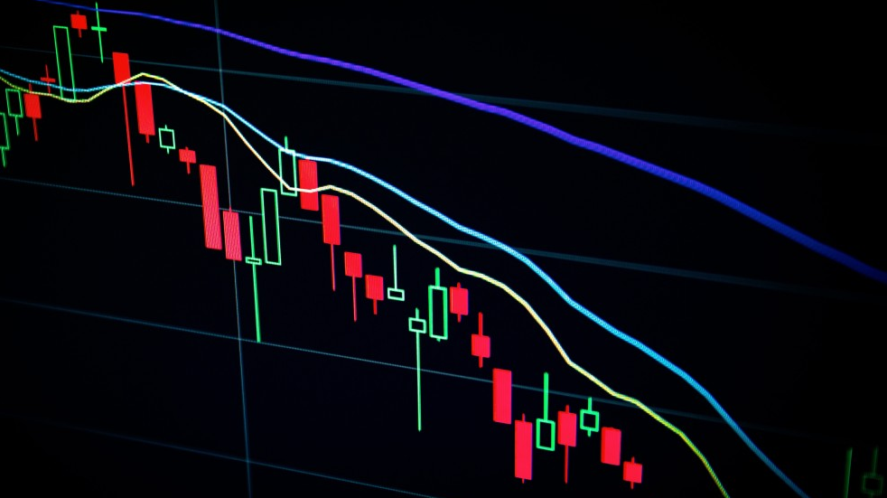
Signature Analysis for Stock Movement Prediction
Group G, Capstone Team 167

Slide 2

Taking advantage of data

Slide 3

What is a signature?
One note at a time
Snapshot of the market, missing overall flow
Capturing the melody, style, interpretation
Analyze sequence of how prices (notes) evolve
How they interact w/ each other (chord progressions, rubato)
Entanglement
Allows us to represent complex relationships linearly using non-linear function
Notes:
Top line melody vs entire chord progression structure

Slide 4
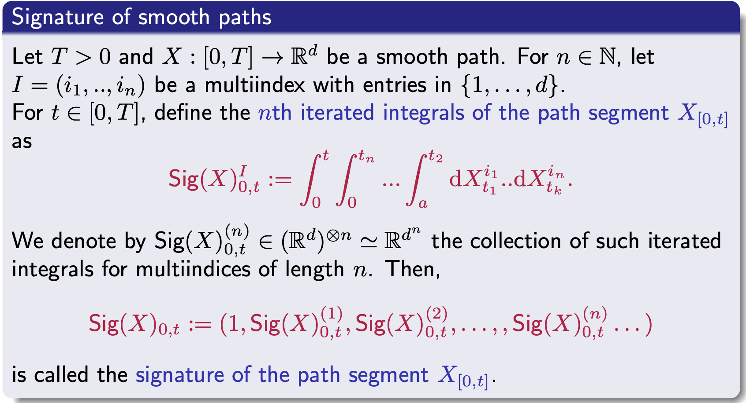

Slide 5
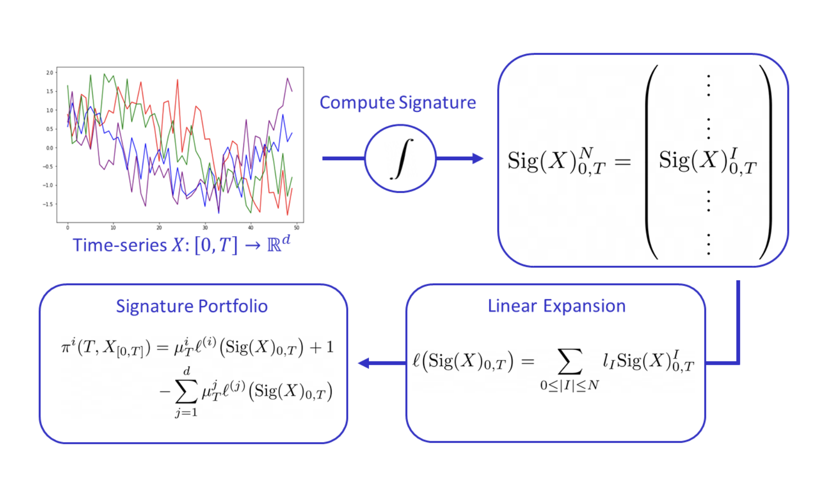

Slide 6
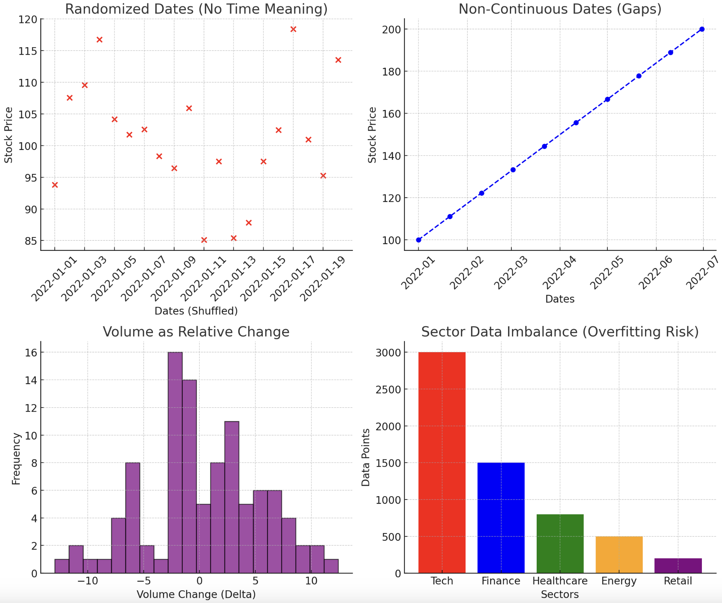
Data Challenges
Randomization of dates
Non-continuous data
We have 20 day snapshots
Relative volume
Expressed as delta
Sector imbalance in data
Causes overfitting in training→ test model
Unidentifiable labels
All represented as some identifier

Slide 7
Model Selection (Ridge)
Handles high dimensional, correlated data
RR handles multicollinearity, distributing importance across features
Good for complex, large feature sets
Ability to use the features of signatures
Captures the nonlinear movements and patterns while using relatively little computational power
Prevents overfitting
Penalizes extreme weight values

Slide 8
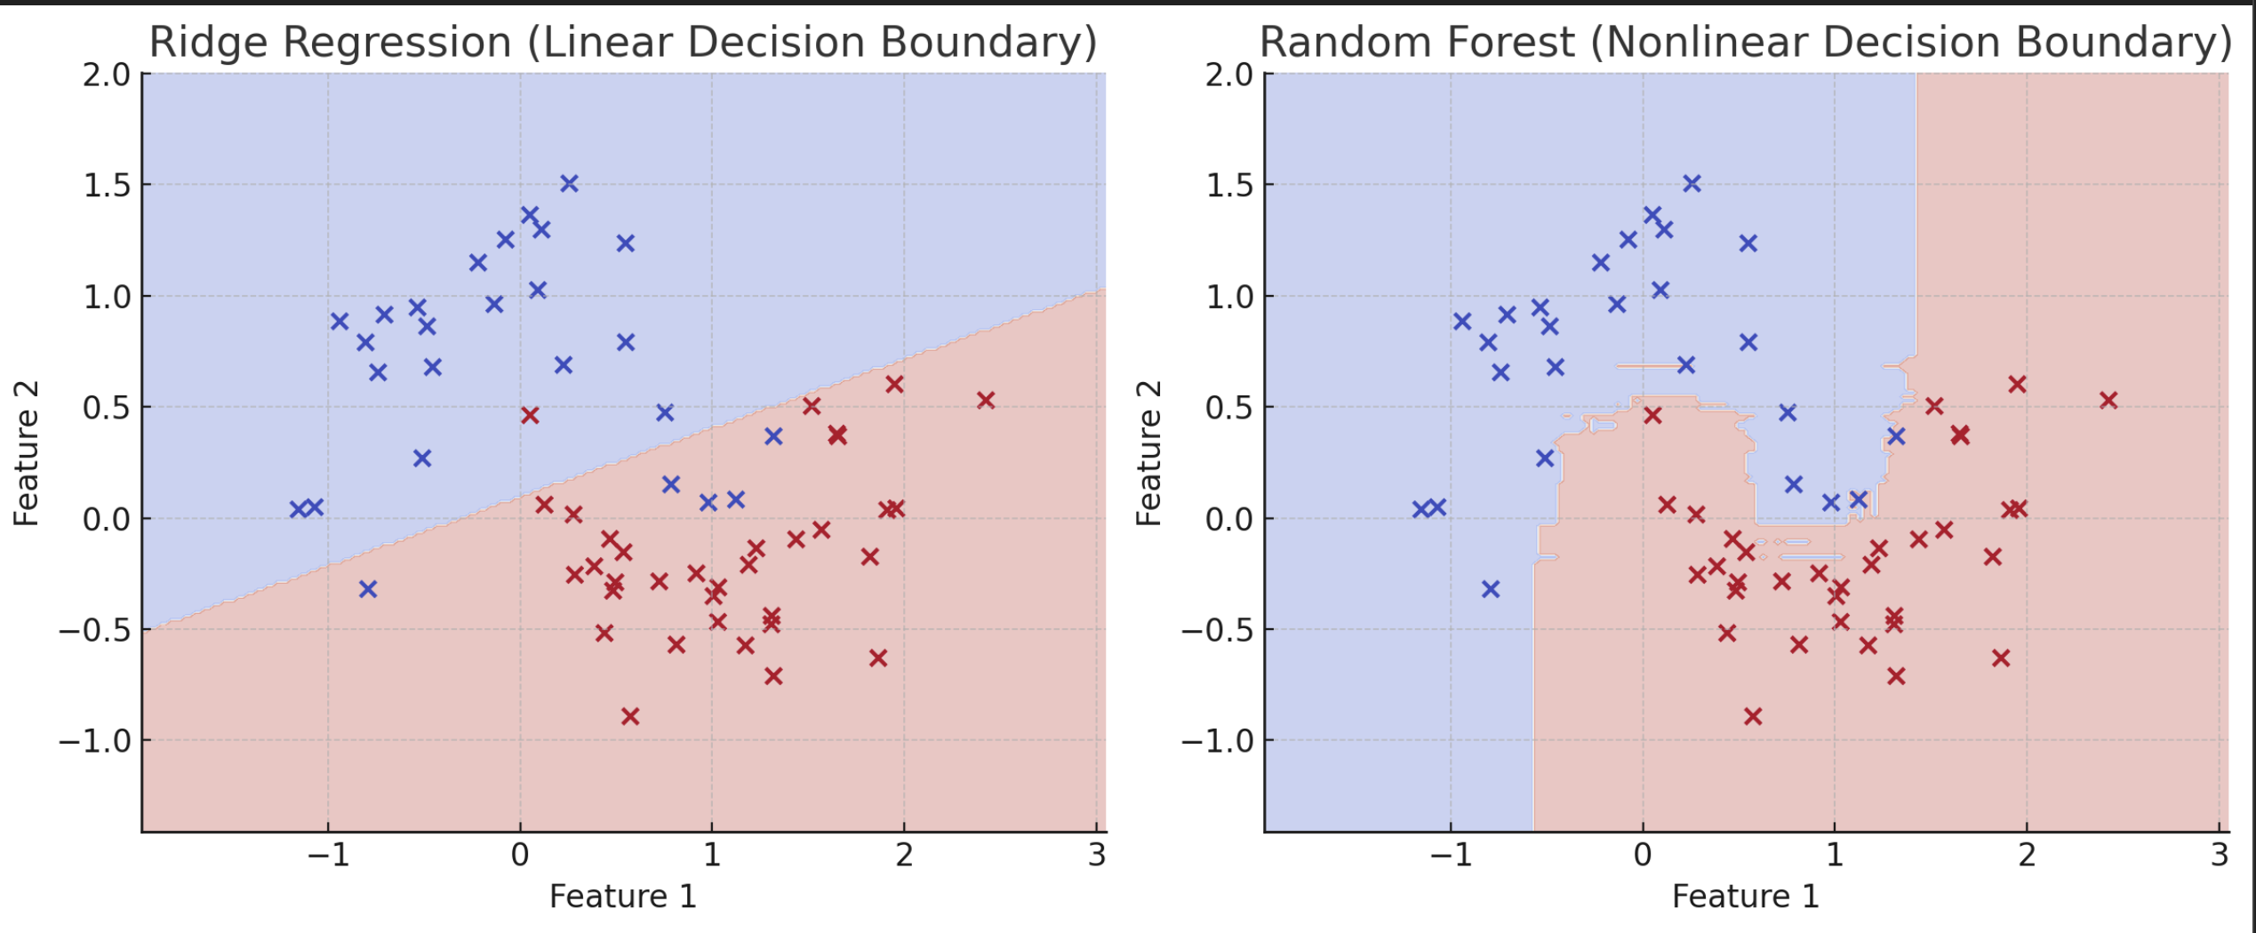
Limitations
Sensitive to feature selection
Helps w/multicollinearity, but does not eliminate unnecessary features
Noise -> bad performance
Assumes linear relationship
Not as flexible as tree-based or deep learning methods
Extreme market events are not captured well
loss penalization term

Slide 9
Current results and Next steps
Finished creating model with signatures up to the 3rd depth
Similar results to random forest tree model from QRT
Seems to be overfitting on data still, so we will use random sampling, avg of stocks in each industry and then compute signatures
Using kernels in order to group stocks by industry

